Slide 1

3RP
REDUCE.REUSE.RECYCLE
01

Slide 2
Our Team
Salonee Sahu-2023000280
Abhiram Aswadhati-2023000014
Sanjana Dasari-2023000377
Akshaya Choudary-2023000420
Prasad S-2023000412
A Ganesh-2023000066

Slide 3
Introduction to E-waste
WHAT IS E-WASTE?
WHY IT MATTERS
OUR GOAL
E-waste refers to discarded electronic devices like smartphones, computers, and appliances that are no longer in use.
Rising e-waste harms the environment and depletes resources.
To explore innovative and sustainable solutions for managing e-waste effectively through recycling, reuse,reduce.

Slide 4
Problem Statement
Waste from Multiple Sources
Waste is produced from various sources, such as:
-Residential and commercial waste
-Industrial byproducts
-E-waste (electronics)
-Plastic and glass waste
Key Statement:The rapid rise of e-waste harms the environment with toxic materials and depletes resources. Traditional waste management methods are ineffective, calling for sustainable solutions.

Slide 5
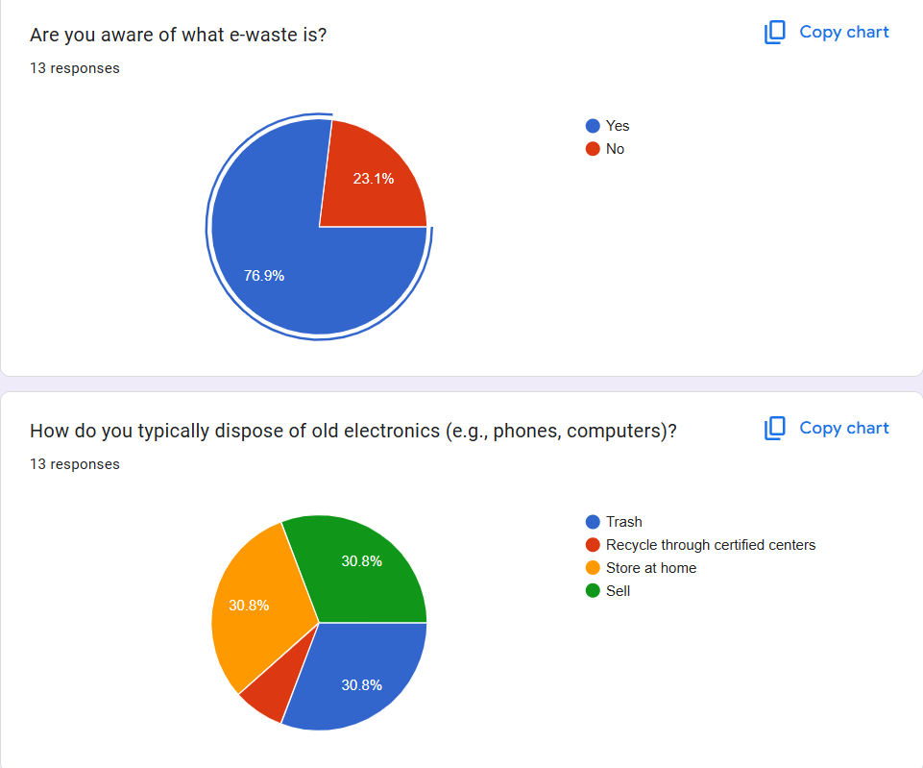
SURVEY

Slide 6
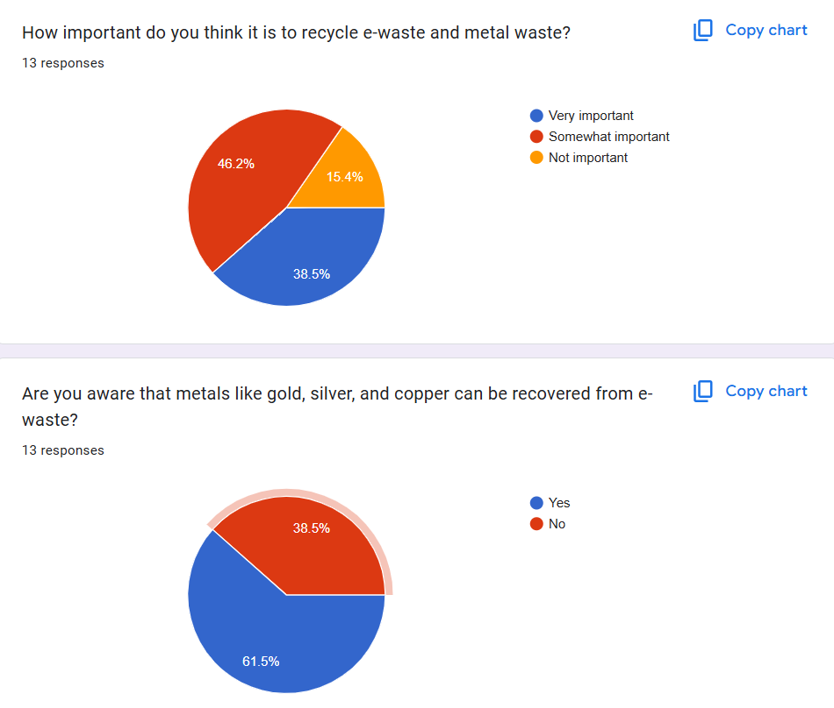
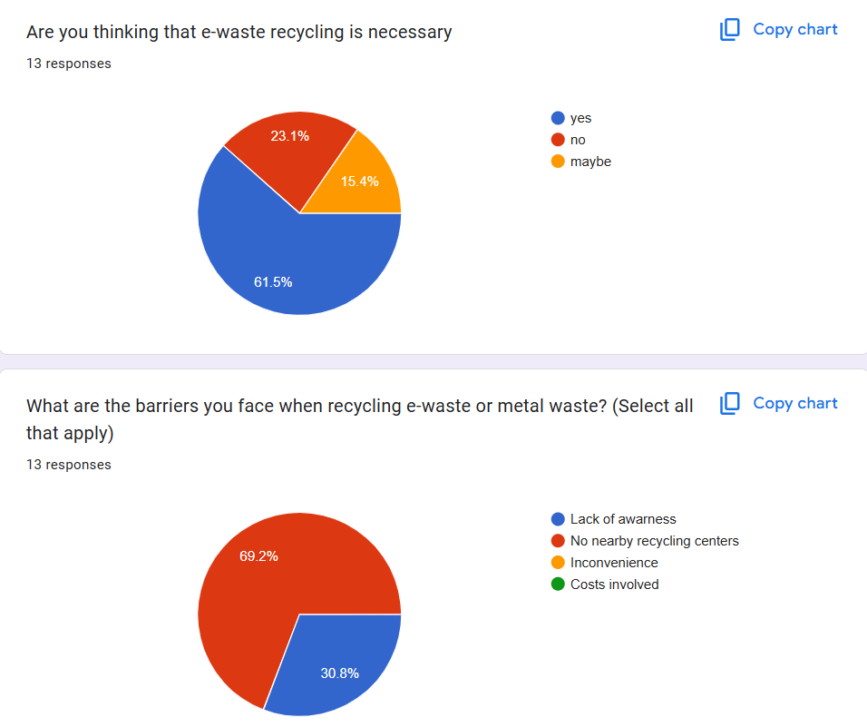

Slide 7
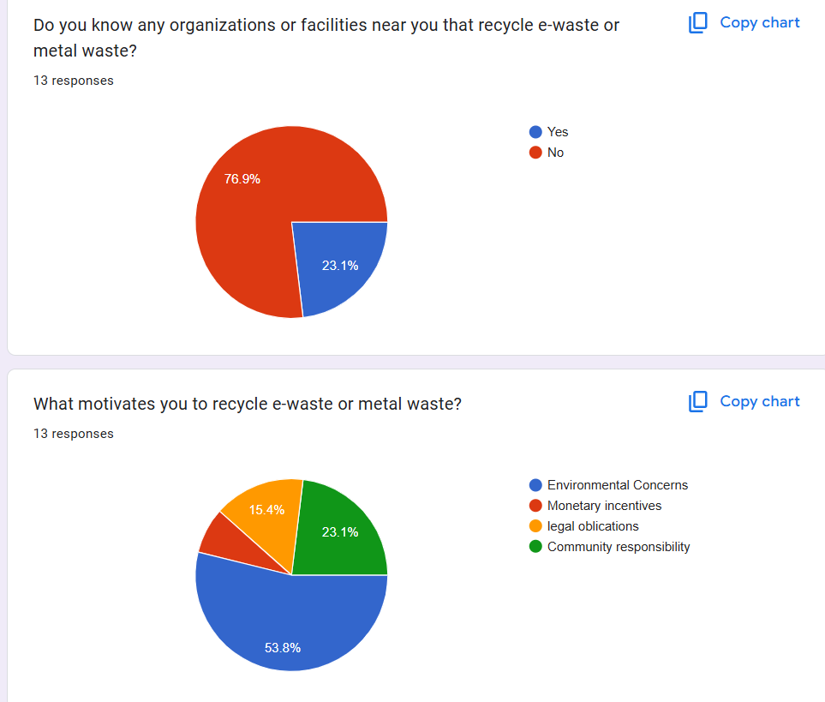

Slide 8
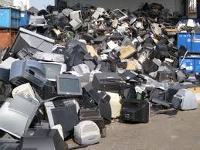
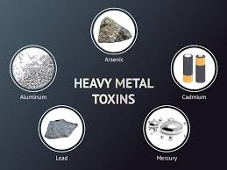
Challenges with Existing Solutions
Landfills and incineration fail to manage e-waste effectively.
Toxic materials like lead and mercury pollute the environment.
Segregating metals and plastics is complex and costly.
Existing methods do not address the environmental impact adequately.

Slide 9
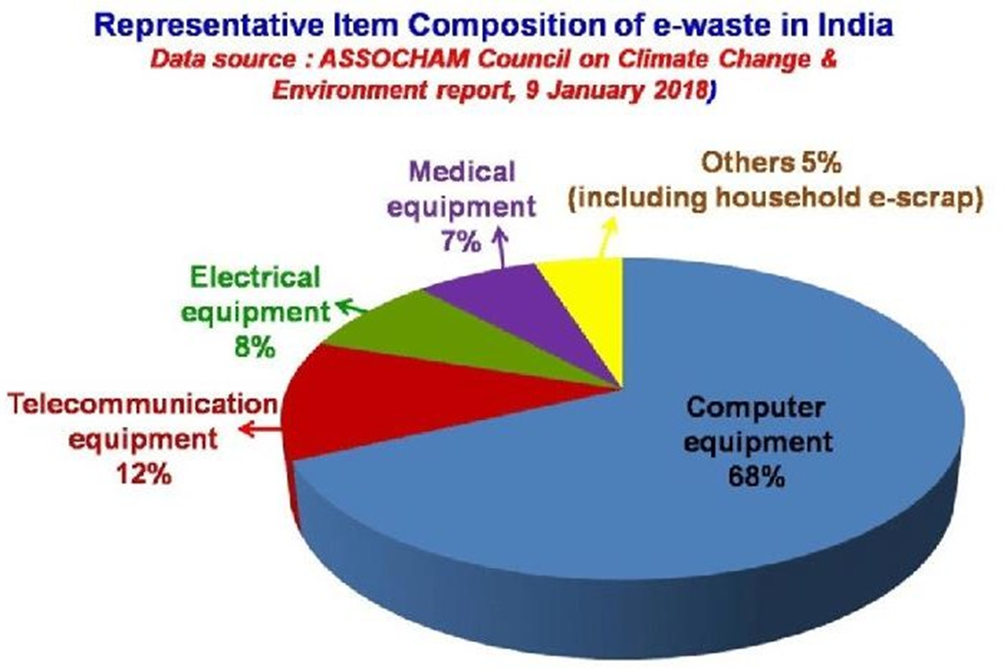
WASTE COMPOSITION
BREAKDOWN
E-WASTE INCLUDES VARIOUS MATERIALS:
-Consumer Electronics (e.g.,laptops)
-Small Appliances (e.g., microwaves)
-Batteries
-Plastics
Materials in e-waste:
-Precious metals (gold, copper)
-Toxic components (lead, mercury
-Recyclable plastics and glass
Proper segregation is crucial for effective recycling.

Slide 10
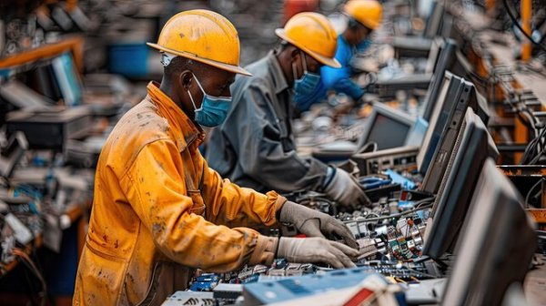
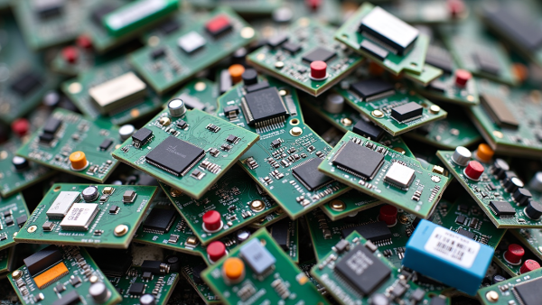
Challenges with Existing Solutions
Traditional methods like landfills and incineration are inadequate for managing e-waste because:
Toxic Materials: Electronics contain hazardous substances (e.g., lead, mercury) that contaminate land and water.
Complex Recycling: Separating metals and plastics from e-waste is costly and difficult.
Environmental Harm: These methods fail to address the toxicity and environmental damage caused by improper disposal.
Key Point: The inefficiency and environmental impact highlight the need for specialized e-waste recycling.

Slide 11
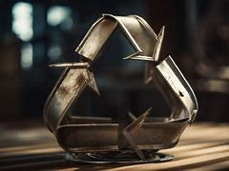
Benefits of E-Waste Recycling: Metal Extraction
Valuable Metals: Recover gold, silver, copper, and palladium for reuse.
Environmental Impact: Reduces harmful mining activities, preserving ecosystems.
Energy Savings: Recycling uses less energy compared to mining raw metals.
Economic Growth: Creates jobs and generates revenue from extracted materials.

Slide 12
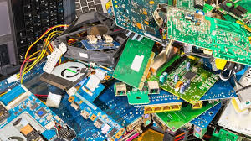
Benefits of E-Waste Recycling: Reuse of Components
Reusing Components: Reduces demand for new parts, lowers costs, and extends material lifespan.
Waste Reduction: Prevents landfill accumulation, minimizing environmental harm.
Resource Conservation: Saves finite resources and reduces production needs.
Recycling Metals: Recovers valuable metals (gold, silver, etc.), reduces mining impact, and saves energy.
Economic Benefits: Creates jobs and generates revenue from recycled materials.

Slide 13
E-WASTE MANAGEMENT PROCESS
STEP-1
STEP-3
Collection and segregation of e-waste from various sources.
Collaboration with recycling companies and industries to refine and process materials.
STEP-4
STEP-2
•Ensuring compliance with safety and environmental regulations to prevent pollution.
Sorting components into reusable parts and recyclable metals.

Slide 14
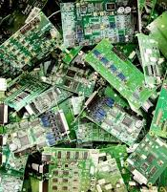
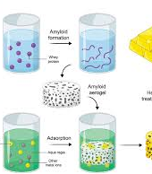
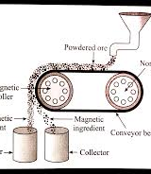
STEP 1
Collection: Devices gathered from consumers, industries, and disposal centers.
STEP 2
Metal Extraction Process from E- Waste
Disassembly: Components separated manually or mechanically.
STEP 3
Shredding: Devices broken into smaller pieces.
STEP 4
Magnetic Separation: Ferrous metals (e.g., iron, steel) removed with magnets
STEP 5
Chemical Extraction: Eco-friendly recovery of non-ferrous metals.{eg.gold,cooper

Slide 15
Parts Reuse Process from E-Waste
STEP-01
STEP-02
STEP-03
Inspection and testing of components to determine their functionality and usability.
Identification of working parts suchas microchips, screens, capacitors, and batteries.
Refurbishment of reusable components by cleaning, repairing, or upgrading them if needed.
STEP-04
STEP-05
Repurposing components in devices or selling as replacement parts.
Resale: Refurbished parts and devices are sold to consumers, businesses, and manufacturers.

Slide 16


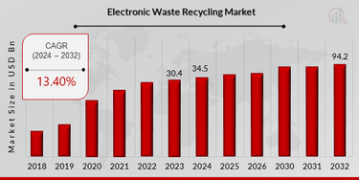


ECONOMIC IMPACT OF E-WASTE RECYCLING
REVENUE GENERATION
JOB CREATION
RECYCLING AND REFURBISHMENT CREATE EMPLOYMENT.
EXTRACTED METALS & REFURBISHED PARTS GENERATE PROFITS.
COST SAVINGS
MARKET GROWTH
REDUCES RAW MATERIAL COSTS FOR MANUFACTURERS.
E-WASTE RECYCLING IS A BOOMING INDUSTRY.

Slide 17


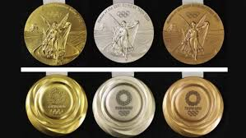

SUCCESSFUL CASE STUDIES IN E-WASTE RECYCLING
DELL’S TAKEBACK PROGRAM – COLLECTS & RECYCLES OLD DEVICES WORLDWIDE.
SWEDEN & CIRCULAR ECONOMY – 99% OF WASTE IS RECYCLED OR REUSED.
INDIA’S INITIATIVES – GROWING E-WASTE RECYCLING STARTUPS LIKE ATTERO RECYCLING.
JAPAN’S E-WASTE POLICY – TOKYO 2020 OLYMPIC MEDALS MADE FROM RECYCLED ELECTRONICS.

Slide 18

Technological Innovations in E-Waste Recycling
AI-Powered Sorting
Identifies and separates valuable materials efficiently.
Robotic Disassembly
Automates dismantling of electronic devices.
Eco-Friendly Metal Extraction
Uses bioleaching & hydrometallurgy to recover metals.
Blockchain for E-Waste Tracking
Ensures transparent & responsible recycling.

Slide 19
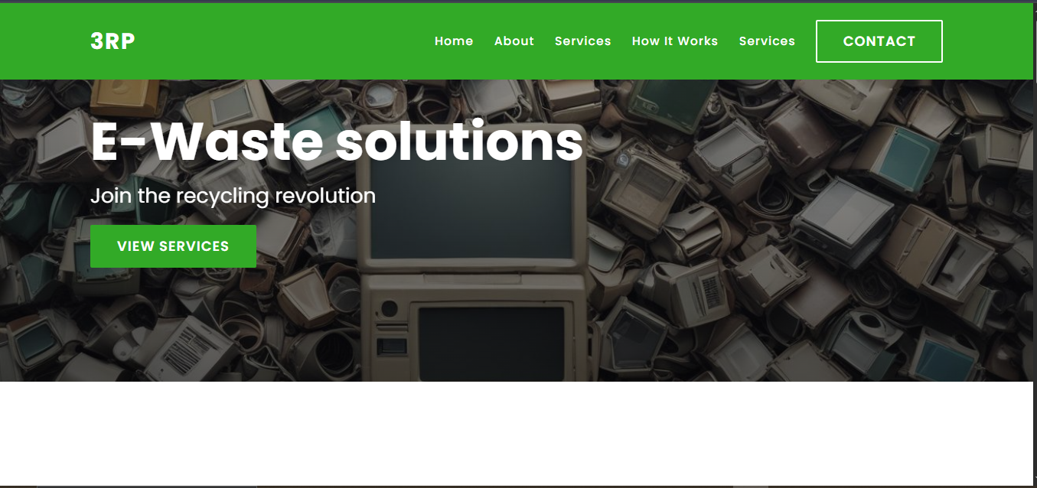
WEBSITE DESIGN

Slide 20
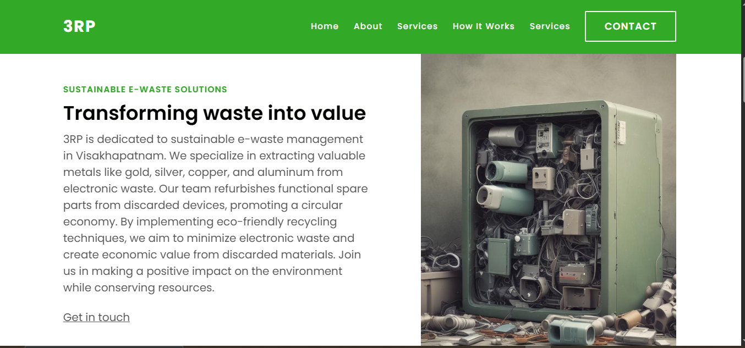
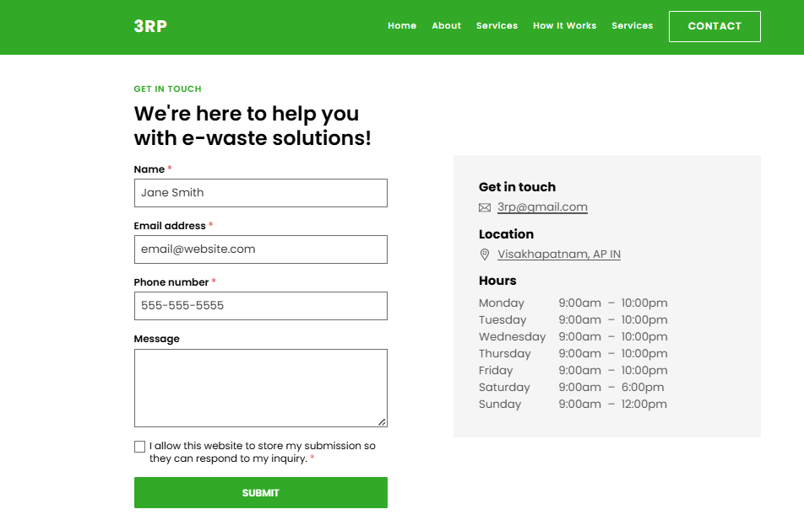
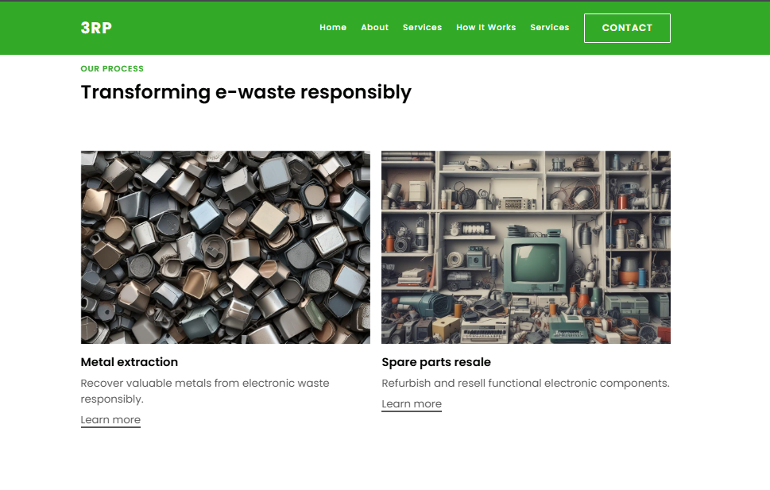
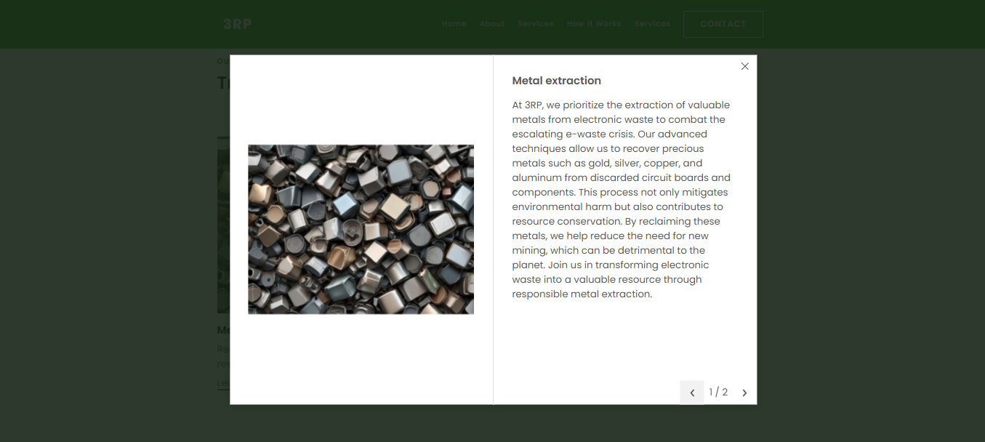

Slide 21
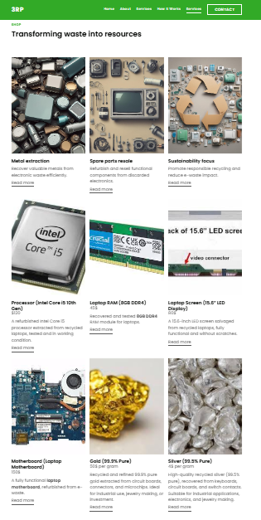
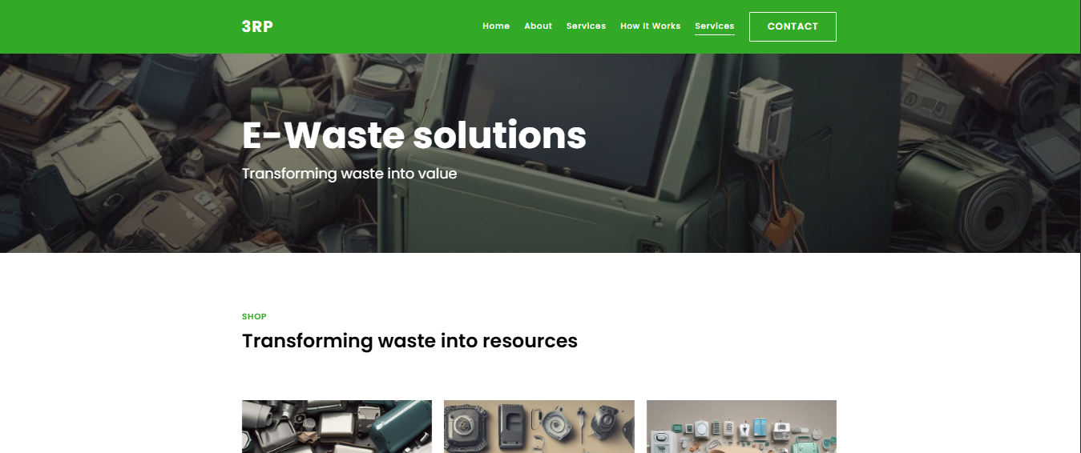

Slide 22
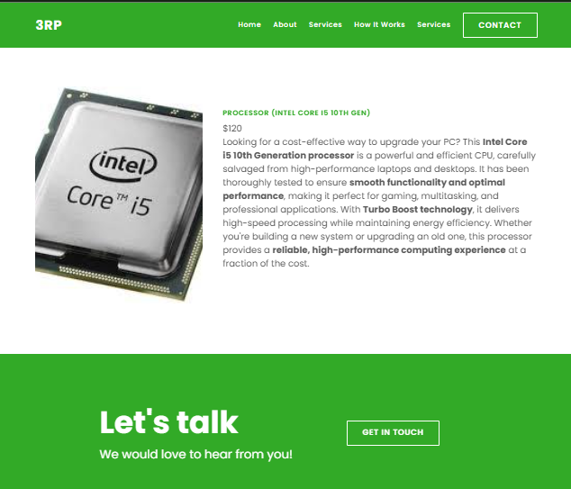
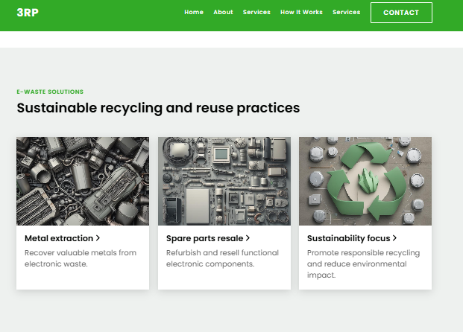
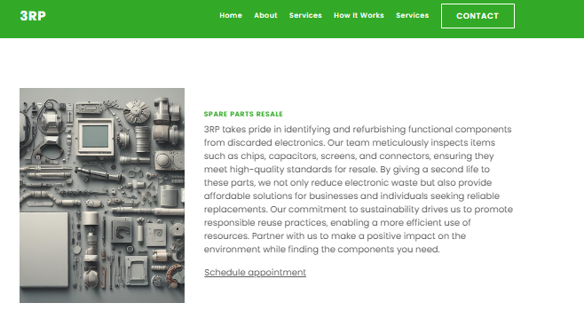

Slide 23
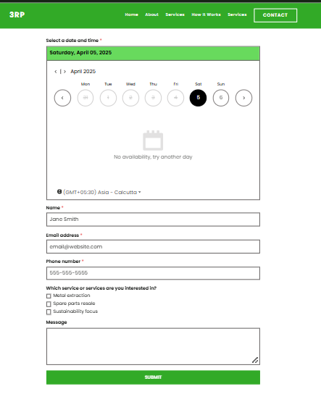

Slide 24
THANK YOU!!

